Slide 1
Stock Movement Prediction from Twitter Sentiment Analysis
Ashish | Shobhit

Slide 2
Agenda
Seed / basis for the project
Approach
Results
Learning and Challenges
Conclusion
Future scope

Slide 3
Seed
Stock price movement is governed by a lot of factors, but a major factor is the general market sentiment.
The market sentiment might be specific to an organization, or about the market as whole.
From a significantly large set of tweets from a single day, we can infer the general market sentiment and use it to predict movement, in addition to how the market has been doing in past couple of days.

Slide 4
Seed
Traditional machine learning approaches use the historical movement of stock prices to predict future prices.
Some approaches also use macro factors, such as how related organizations in that sector are doing.
This opens an opportunity for us to explore addition of another factor in that prediction – what the public has to say – by capturing sentiment.

Slide 5
Approach
Our approach consists of following steps:
Training an independent model to classify the sentiment from a Tweet. We used Kaggle Sentiment140 dataset (containing 1.6 million tweets) for this to train RNN, GRU, and LSTM models and use the best model later.
We built a dataset of Tweets that correspond to indexed organizations and use our pre-trained model to label these Tweets as having positive or negative sentiment (Attributes: tweet_body, sentiment, date, ticker_symbol).
We built another dataset consisting of stock prices (open, close) corresponding to the dates and ticker_symbol from the dataset in step 2.

Slide 6
Approach
In our evaluation, we found in addition to the opening and closing price for stocks, it helps to introduce the following derived attributes:
Volatility = (last close price – current close price) / last close price
Momentum = 1 if current close price is higher than last, 0 otherwise
Average Volatility = Mean of Volatility for last 5 days
Delta = Day’s closing price – day’s opening price
Movement = Current closing price – last closing price

Slide 7
Approach
We then merge these two datasets to form a dataset that we use for training our model. We merge it in the following way:
Group tweets by date and normalize number of positive and negative tweets for that date to calculate a sentiment score as p / (p + n).
Then group them by ticker_symbol, and add attibutes volatility, momentum, average_volatility, delta for that ticker_symbol.
Finally, for the label for that example we use the attribute momentum (for movement prediction) and delta (for value prediction) for that ticker symbol.

Slide 8
Approach
After we’re ready with the dataset, we built separate models to predict the:
Magnitude of movement on stock prices using a LogisticRegression and SVM models. (X = [Volatility, AvgVolatility, positive_sentiment], Y = [Delta])
Direction of movement on stock prices using a LogisticRegression, SVM, and a KNeighborsClassifier model. (X = [Volatility, AvgVolatility, positive_sentiment], Y = [Momentum])
Traditional approaches use time-series models such as LSTMs, or regression over just the stock prices over a long range. We wanted to try a new approach of doing regression over inputs that contain some local context information (from past five datapoints), as well as the public sentiment.

Slide 9
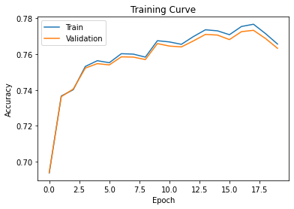
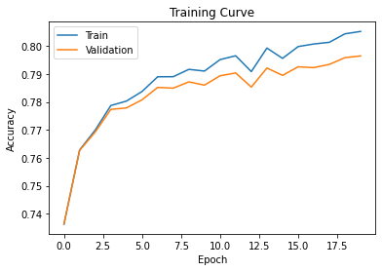
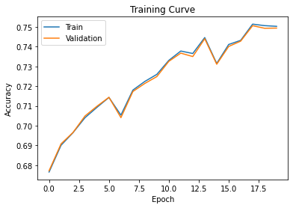
Results
For the sentiment classifier model, we tried various models:
RNN
Glove emb_dim: 50
Validation Accuracy after 20 epochs: 0.76
RNN
Glove emb_dim: 100
Validation Accuracy after 20 epochs: 0.79
Stacked RNN
Glove emb_dim: 50
Validation Accuracy after 20 epochs: 0.75
Adam optimizer (lr=2e-4), CrossEntropy loss

Slide 10
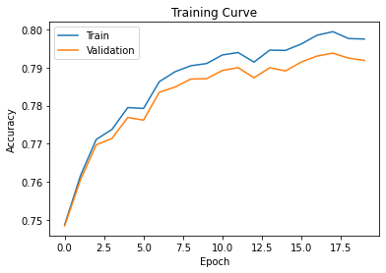
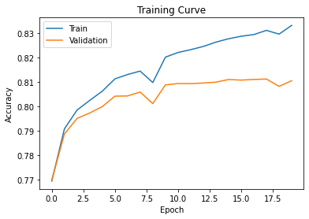
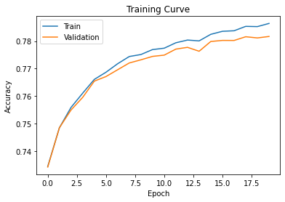
Results
For the sentiment classifier model, we tried various models:
GRU
Glove emb_dim: 50
Validation Accuracy after 20 epochs: 0.79
GRU
Glove emb_dim: 100
Validation Accuracy after 20 epochs: 0.81
Stacked GRU
Glove emb_dim: 50
Validation Accuracy after 20 epochs: 0.78
Adam optimizer (lr=2e-4), CrossEntropy loss

Slide 11
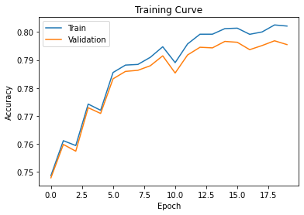
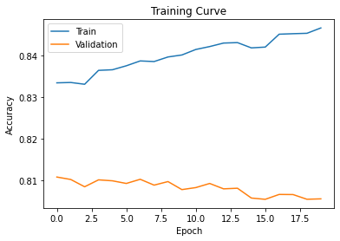
Results
For the sentiment classifier model, we tried various models:
LSTM
Glove emb_dim: 50
Validation Accuracy after 20 epochs: 0.795
LSTM
Glove emb_dim: 100
Validation Accuracy after 20 epochs: 0.80
Adam optimizer (lr=2e-4), CrossEntropy loss

Slide 12
Results
For the stock price movement value prediction model, we obtained following test MSE scores across different models:
Linear Regression | SVM-linear | SVM-poly | SVM-rbf | SVM-sigmoid
4.12 | 5.42 | 4.24 | 4.52 | 42.01

Slide 13
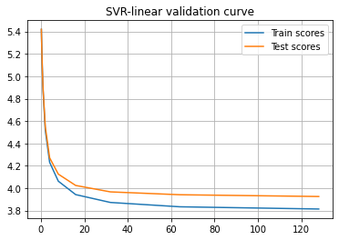
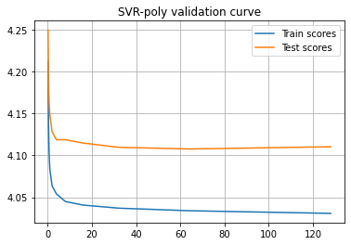
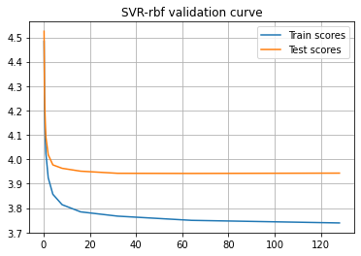
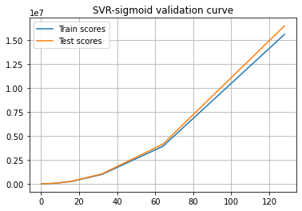
Results
Validation curves for stock price movement value prediction models (MSE scores):

Slide 14
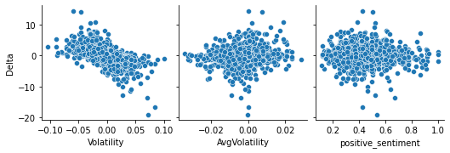
Results
Correlation of Delta with different attributes:

Slide 15
Results
For the stock price movement direction prediction model, we obtained following test accuracy scores across different models:
Logistic Regression | SVM-linear | SVM-poly | SVM-rbf | SVM-sigmoid | KNN Classifier
0.96 | 0.97 | 0.99 | 0.98 | 0.50 | 0.94

Slide 16
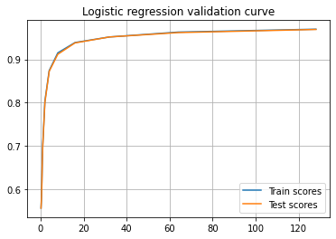

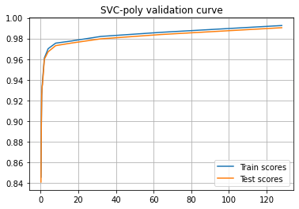
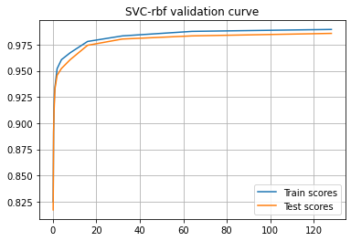
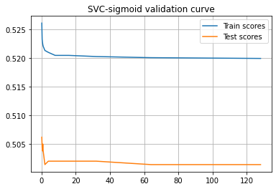
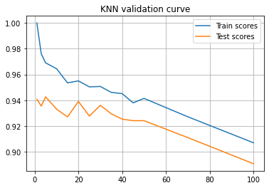
Results
Validation curves for stock price movement direction prediction models (acc scores):

Slide 17
Learnings and Challenges
The curation of datasets was the biggest challenge. As no end-to-end dataset for our use case existed in the wild, we had to spend a lot of time cleaning and pruning datasets to satisfy our needs. This helped us learn how to build our own datasets for the task at our hands.
A key learning was in producing the idea of using a trained model’s predictions to serve as a feature for another dataset, and in a way chaining different models.
We also learnt to evaluate different models and strategies at our hands, like figuring out what model would work the best for sentiment classification and tuning the parameters ourselves.

Slide 18
Conclusion
Despite the task seeming straightforward at first at the time of proposal, in the implementation phase we realized stock movement prediction is super challenging due to the plethora of factors it depends on. Public sentiment is just a tiny factor involved in the movement. Nevertheless, it was an amazing learning experience working on such challenging project over the summers.
We developed an independent sentiment classification model with a pretty good accuracy (~ 0.8).
We curated large datasets, something we had never done before.
We built a various models to finally predict the movement and fed a set of derived attributes to it to maintain a locality context of five days. We achieved a good accuracy in movement direction prediction.

Slide 19
Future Scope
Realizing the limitations of the project, we believe the following improvements could be made to make the predictor more robust.
Using ensembles to annotate data - currently, we train a bunch of models for sentiment classification. After training, we use the best model, and discard all the others. This results in poor utilization of trained models. We could instead construct an ensemble of all the performant classifiers and use them to annotate the tweets as positive/negative.
Range of dates of tweets - The size of the dataset of our stock prediction task is linearly dependent on the number of dates we choose our tweets from. While it is easier to fetch historical stock price data, it is much more difficult to fetch tweets spanning over a huge timeline. This demands a high amount of disk storage, compute and memory. However, using distributed computers or sophisticated devices, this may very well be possible.
For cross validation, we only searched the regularization parameter. However, there are many other parameters that must be searched for obtaining a more performant predictor that generalizes well.

Slide 20
Q & A

Slide 21
Thank You!

